Slide 1

“A Gospel Worth
Accepting and Affirming ”
2:1 – 10
Week 4
9 February 2022

Slide 2


Slide 3

Galatians Questions From Last Lesson
What does Paul stress about the gospel he preached? (11-12)
It is not according to man (neither received from man, nor was taught it).
It came through the revelation of Jesus Christ.
2) What did Paul remind them concerning his former conduct in Judaism? (13-14)
How he persecuted the church of God and tried to destroy it.
How he advanced in Judaism beyond many of his contemporaries.
3) Why did God call Paul and reveal His Son in him? (v15-16)
To preach Christ among the Gentiles.

Slide 4
Galatians Questions From Last Lesson
4) Where did Paul NOT go after his conversion? (v17)
To Jerusalem and the apostles who were there.
5) How long was it before Paul saw any of the apostles in Jerusalem? Which ones did he see? (v18-19)
Three years.
Peter and James, the brother of Jesus.
6) What three things are said of Paul with the Church? (v22-24)
He was unknown by face to them.
They were only hearing about his preaching.
They glorified God because of Paul.

Slide 5

A Gospel Worth
Accepting and Affirming

Slide 6
Galatians Ch2 Overview
As Paul continues defending his apostleship, he describes a meeting in Jerusalem fourteen years after the one with Peter referenced in chapter one. It was prompted by a revelation, and Barnabas and Titus went with him to meet “those who were of reputation.”
The meeting was private, but some false brethren were secretly brought in who sought to demand that Titus, a Gentile, be circumcised. Paul refused, viewing it as an effort to bring them back into bondage from which Christ set them free (1-5).

Slide 7
Galatians Ch2 Overview
The result of the meeting was that “those who seemed to be something” added nothing to Paul. In fact, once they saw that the gospel of the uncircumcised had been given to him just as the gospel of the circumcised had been given to Peter, and once James, Cephas, and John perceived the grace that had been given to Paul, he was extended the right hand of fellowship.
They only asked that Paul be mindful of the poor, something he was very eager to do (6-10).

Slide 8
Galatians Ch2 Overview
The rest of the chapter describes a confrontation in Antioch between Peter and Paul. Peter, who was visiting, at first was willing to eat with the Gentiles; but when some came from James, out of fear he withdrew himself. Through his influence the rest of the Jews, even Barnabas, were carried away into hypocrisy.
This prompted Paul to withstand Peter “to his face,” and to rebuke him in the presence of all. In the course of his rebuke, Paul stressed that we are justified by faith in Christ, and not by the works of the law, otherwise Christ died in vain (11-24).

Slide 9
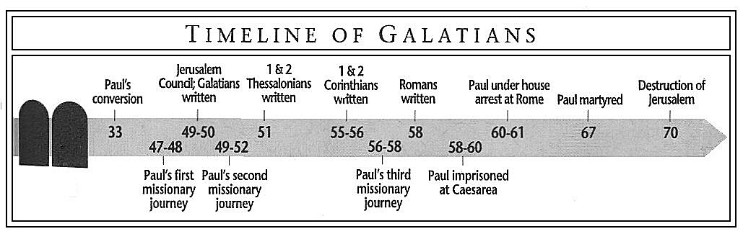

Slide 10
Year (AD) | Paul’s Timeline | Church Time
5 | Birth
32 - 35 | Persecutes the church of Jesus Christ Present at Stephen’s death | Crucifixion of Christ
35 - 38 | Conversion on Damascus Road Travels to Damascus Travels to Arabia: stay 3 years (1:17)
38 – 42 | Returns to Damascus but exits the city for safety Goes up to Jerusalem (1:18) Goes back to Tarsus for safety
44 | Barnabas bring Paul from Tarsus to Antioch Barnabas and Paul make a famine visit to Jerusalem
44 - 46 | Paul in Antioch
47 – 49 | Paul and Barnabas travel to Antioch Later, both travel on First Missionary Journey
49 | Paul and Barnabas travel to Jerusalem Council after 14 yrs (2:1) Paul and Barnabas return to Antioch (2:11-14)
49 – 52 | Barnabas and John Mark sail to Cyprus Paul and Silas travel on Second Missionary Journey
53 - 58 | Paul and Silas travel on Third Missionary Journey

Slide 11
Galatians
Background:
In Galatians 1, Paul proved his apostolic authority by reminding the Galatians that Jesus Christ Himself was the source of both his calling and his gospel message (1:1, 11-12). In the first leg of his argument, he emphasized that his gospel had reached its maturity apart from any input by the first apostles.
Paul’s was an independent witness of Christ and of the good news of salvation by faith in Him. None of it was dependent on any human being. But this leave open the possibility that perhaps—just perhaps—Paul’s gospel was different from that of the Jerusalem apostles.

Slide 12
Galatians
Background:
Perhaps Paul received a reliable message from Jesus, but then he twisted it to his own ends. Maybe he had compromised it to suit the Gentile culture.
Surely the fourteen years after his conversion had afforded enough time for pollutants to work their way into his message and spoil what had once been a pure version of Jesus’ teaching.

Slide 13
Galatians
Background:
These charges sound perfectly plausible. Most likely the Judaizers were using such reasonable-sounding arguments as wedges to create a breach of trust between Paul and the Galatian believers. Apparently that strategy was working, because Paul felt the need to prove the veracity of his version of the gospel in the second chapter of Galatians.
He does this by showing not only that he was unified with the Jerusalem apostles in his message but also that they affirmed him in his ministry to the Gentiles.

Slide 14
Galatians 2:1 – 2
¹Then after fourteen years, I went up again to Jerusalem, this time with Barnabas. I took Titus along also. ²I went in response to a revelation and, meeting privately with those esteemed as leaders, I presented to them the gospel that I preach among the Gentiles. I wanted to be sure I was not running and had not been running my race in vain.

Slide 15
Galatians 2:1 – 2
Paul made it clear earlier in his letter that he had received his message from God and not from people. This section explains why he went up to Jerusalem the second time fourteen years after his conversion. He did so “because of a revelation” (2:2).
So, taking with him his companions, Barnabas, a Levite who had earlier introduced him to the Jerusalem church (Acts 9:27), and Titus, a Gentile convert to Christianity, Paul traveled to the “mother church” in Jerusalem.
There the renowned leaders Peter, James (the brother of Jesus), and John still lived, leading the growing, international church from its original epicenter.

Slide 16
Galatians 2:1 – 2
Since Paul’s original departure from Jerusalem over ten years earlier (Acts 9:26-30), several significant events had transpired:
Paul settled down in Tarsus, his hometown, in southeastern Asia Minor (Acts 9:30).
Peter received a revelation from God that the gospel of salvation was for the Gentiles also (Acts 10:1-16).
Peter preached the gospel to the first official Gentile convert, the Roman centurion Cornelius, who converted with his whole family (Acts 10:17-48).

Slide 17
Galatians 2:1 – 2
Since Paul’s original departure from Jerusalem over ten years earlier (Acts 9:26-30), several significant events had transpired:
Peter initially received resistance from the “circumcision party” in Jerusalem for accepting the uncircumcised Gentiles into the church, but they changed their minds after hearing Peter’s account of his revelation from God (Acts 11:1-18).
Greek-speaking Gentiles in Antioch accepted the gospel when it was preached to them by Jewish believers who had been scattered because of the persecution after Stephen’s death (Acts 11:19-21).

Slide 18
Galatians 2:1 – 2
Since Paul’s original departure from Jerusalem over ten years earlier (Acts 9:26-30), several significant events had transpired:
The Jerusalem church sent Barnabas to Antioch to teach and lead the new Greek converts there (Acts 11:22-24).
Overwhelmed with the ever-increasing responsibilities in Antioch, Barnabas fetched Paul from Tarsus, then spent a year ministering with him in Antioch (Acts 11:25-26).

Slide 19
Galatians 2:1 – 2
When Paul, Barnabas, and Titus arrived in Jerusalem, they not only presented the love offering to the apostles in order to mitigate the effects of the famine but also “presented to them the gospel” of salvation Paul had been preaching among the Gentiles in Tarsus and Antioch (2:2).
Paul, however, wisely chose to meet with the Jerusalem leadership privately rather than in a pubic forum. It is likely that, based on reports from the prophets and teachers who had come from Jerusalem to Antioch, Paul would have known that Peter’s inclusion of Gentiles into the church had already caused some controversy (cf. Acts 10-11).

Slide 20
Galatians 2:1 – 2
The Jerusalem church had been coping with an ultra-traditional party of Judaizers who were itching to push this controversy to a whole new level.
Paul’s worries about having been running “in vain” (2:2) did not stem from a fear that Jesus had taught him the wrong gospel. His concerns were practical rather than theological. If leaders like Peter, James—the brother of Jesus—and John appeared to waver or waffle at all in their support for the thriving ministry among the Gentiles in their daughter church in Antioch, Paul “feared that his past and present ministry might be hindered or rendered of no effect by the Judaizers. That is, the potential controversy that could erupt in a public hearing could have a very disruptive outcome.

Slide 21
Galatians 2:3 – 5
³Yet not even Titus, who was with me, was compelled to be circumcised, even though he was a Greek. ⁴This matter arose because some false believers had infiltrated our ranks to spy on the freedom we have in Christ Jesus and to make us slaves. ⁵We did not give in to them for a moment, so that the truth of the gospel might be preserved for you.

Slide 22
Galatians 2:3 – 5
In Galatians 2:1, Paul notes that the uncircumcised Gentile convert Titus had joined him and Barnabas on their trip to Jerusalem. Titus served as a sort of test case. Would the apostles in Jerusalem agree with Paul that salvation comes through faith alone in Christ alone?
Or would the Jerusalem church leaders require Titus to undergo the normal means of conversion to Judaism—circumcision—in order to partake of the salvation originally meant for the Jewish people?
How did “those who were of reputation” respond (2:2)? Paul writes, “But no even Titus, who was with me, thought he was a Greek, was compelled to be circumcised” (2:3).

Slide 23
Galatians 2:3 – 5
Be reminded that one of the urgent challenges that incited Paul to write Galatians was that Judaizers in Galatia were compelling the Galatians to be circumcised (6:12).
The point is that even in Jerusalem, the center of Judaism, in the presence of the original Jewish followers of Jesus, surrounded by the most Law-loving Jews in the world, nobody compelled Gentile believers in Jerusalem to be circumcised.
What sense would it make, then, for the Judaizers to insist on enforcing the rite of circumcision for Gentile believers living in the remote regions of Galatia?

Slide 24
Galatians 2:3 – 5
Paul then zooms in on the opponents he had been trying to avoid in Jerusalem (2:4-5). Paul describes these “false brethren” in military terms indicating the subversive and militant nature of the evil that Paul was fighting . . . secretly – sneaked – spy – bondage.
Paul saw himself in the midst of a life-and-death battle, striving to protect a priceless treasure: the gospel of Jesus Christ. Judaizing spies whose loyalty remained with the old Law of Judaism were merely playing the part of followers of Christ, having infiltrated the ranks of the church in order to destroy the doctrine of grace from the inside out.

Slide 25


Slide 26
Galatians 2:3 – 5
And the best way to destroy grace is to enslave believers with a strenuous religious system including:
prerequisites for meriting salvation;
rituals to receive salvation; and
righteous works to maintain salvation.
If Paul and Barnabas had sought peace at any price, the brilliant light of the glorious gospel of grace would have been eclipsed by the waning, reflected glory of an obsolete covenant of works.

Slide 27
Galatians 2:3 – 5
And if the Judaizers had won a victory at the Christian command center in Jerusalem, the outposts of the true faith would have suffered similar attacks at the hands of an emboldened insurgency of self-righteous frauds.
This is why Paul and his associates refused to yield to the demands of the false teachers “for even an hour” (2:5). The survival of the truth of the gospel itself was at stake, and Paul wasn’t willing to give even an inch.

Slide 28
Galatians 2:6 – 9
⁶As for those who were held in high esteem—whatever they were makes no difference to me; God does not show favoritism—they added nothing to my message. ⁷On the contrary, they recognized that I had been entrusted with the task of preaching the gospel to the uncircumcised, just as Peter had been to the circumcised. ⁸For God, who was at work in Peter as an apostle to the circumcised, was also at work in me as an apostle to the Gentiles. ⁹James, Cephas, and John, those esteemed as pillars, gave me and Barnabas the right hand of fellowship when they recognized the grace given to me. They agreed that we should go to the Gentiles, and they to the circumcised.

Slide 29
Galatians 2:6 – 9
Paul calls the apostles Peter and John, along with James (the brother of Jesus), “those who were of high reputation” (2:6) and men “who were reputed to be pillars” (2:9). He also makes this enigmatic parenthetical statement: “What they were makes no difference to me” (2:6).
Should we read these statements as a subtle put-down of these men? Not at all! Remember, in light of the Judaizers’ schemes in Galatia, the last thing Paul needed was to find himself and Barnabas on the wrong side of the original Jerusalem apostles. That would have played right into the Judaizers’ hand.

Slide 30
Galatians 2:6 – 9
Besides, Paul was bringing a financial gift to that church, demonstrating love and unity with them. Controversy and schism were not on his agenda. We should instead read these statements in light of the Judaizers’ attempt to put Paul in his place by overemphasizing the authority of the “super apostles” in Jerusalem (cf. 2Cor. 11:5).
The Judaizers likely viewed James, Peter, and John as real apostles, and Paul as an imposter. James, Peter, and John had known Christ during His earthly ministry; Paul had not. They ministered primarily to Jews: Paul brought the “unclean” people into the church, and let them remain “unclean.”

Slide 31
Galatians 2:6 – 9
So, the Judaizers must have expected the hammer to fall on Paul when they saw the results of his radical “anything goes” gospel: an uncircumcised Gentile believer in Christ, Titus, standing right in their midst. What a surprise those Judaizers must have had when the pillars of the church in Jerusalem not only accepted Titus as a brother in Christ but also affirmed Paul’s ministry to the Gentiles!
To the consternation of Paul’s enemies, Peter, James, and John accepted him as an equal. They recognized that one God was directing their different ministries, one grace was empowering their different missions, and one gospel was the driving force in everything they did.

Slide 32
Galatians 2:6 – 9
The wedge the Judaizers had tried to drive between the leaders in Jerusalem and the missionaries in Antioch became a stake driven through the heart of those false teachers trying to suck the life out of the gospel of grace. Not only did the Jerusalem leaders add nothing to Paul’s gospel (2:6), but they extended the “right hand of fellowship” to Barnabas and Paul, blessing the continuation of their work among the Gentiles (2:7-9). The win-win result must have thrilled Paul and Barnabas!
Think about why. On that epochal day, rather than being scolded in front of their opponents, put in their places, and then sent back to Antioch stripped of their ministry, Paul and Barnabas received a three-fold endorsement . . .

Slide 33
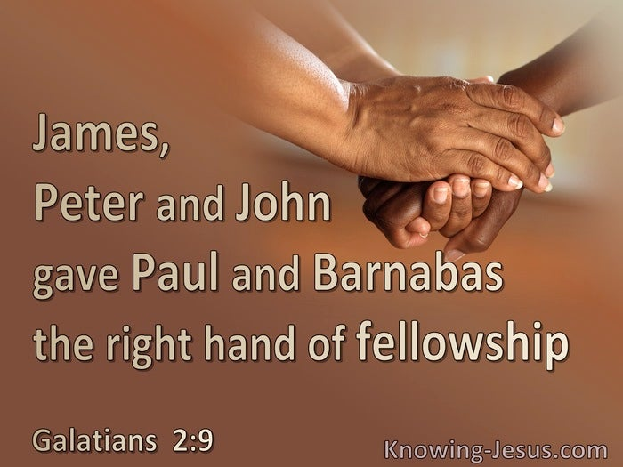

Slide 34
Galatians 2:6 – 9
First, the apostolic leaders saw Paul’s distinctive contributions to the work of the ministry. They realized that Paul and Barnabas represented not a competing message but a complementary ministry (2:7). Peter had been sent to the Jew, Paul to the Gentile.
Second, they put Paul’s ministry on par with Peter’s. The church leaders saw that although Peter and Paul had different ministries, their empowerment and authority came from the same source—God (2:8). Because both ministries had clear evidence of God’s miraculous confirmation, it was clear that God had shown favor to each of them. The only solution was to view the situation from God’s perspective: Paul and Peter represented unity and diversity in the body of Christ.

Slide 35
Galatians 2:6 – 9
Third, they recognized the grace given to Paul and encouraged him to press on. Seeing that Paul had the gifts, skills, training, and experience to minister to the Gentiles, the apostles urged him to keep at his God-given task (2:9).
Paul and Barnabas had presented a clear and compelling case that their ministry to the Gentiles was in perfect harmony with Peter’s own realization several years earlier: Apart from circumcision or any other work of the Law, “the gift of the Holy Spirit had been poured out on the Gentile also” (Acts 10:45).

Slide 36
Galatians 2:10
¹⁰All they asked was that we should continue to remember the poor, the very thing I had been eager to do all along.

Slide 37
Galatians 2:10
In the midst of this doctrinal discussion, however, the Jerusalem apostles did add one thing—a reminder. Understand, this wasn’t something they added to the gospel message as a requirement for salvation, but something they urged Paul not to forget: “Remember the poor” (2:10).
Why would the apostles interject this reminder, especially in light of the fact that the primary purpose of Paul’s visit was to bring a substantial gift for the poor and suffering in Jerusalem?
It may be that the apostles recognized that an emphasis on doctrinal purity could lead to a neglect of practical ministry.

Slide 38
Galatians 2:10
Truth be told, a church may have all its theological t’s crossed and i’s dotted, but they tremble at the thought of actually getting their hands dirty by reaching out to the poor, the needy, the helpless, and the hopeless.
What a tragedy! The most generous, self-sacrificial, and philanthropic people in the world should be those who have come to terms with the theological truth of the depth of God’s grace and mercy. This is why Paul responded that he wasn’t about to neglect the needs of the poor. This was something he was “eager to do” (2:10).
Right doctrine and right practice. Both of these were confirmed by the Jerusalem apostles, vindicating Paul’s authority as an apostle of the true gospel of Jesus Christ.

Slide 39


Slide 40

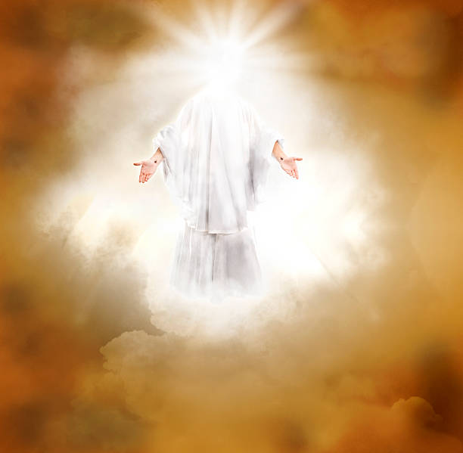

Slide 41
NEXT CLASS – 16 Feb 2022
Book of Galatians
Before next class, read the below verses in the KJV and the NIV, plus one additional versions of the Bible, i.e., NRSV, NLT, NKJV, etc …
Chapter 2:11 – 21
“Going Head-to-Head with Hypocrisy”
EBC Website for Handouts
https://bit.ly/surveyofpaulineepistles

